Slide 1
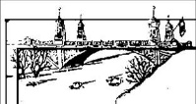
Stormwater – Research the problem
Lesson 7
City of Asotin
City of Clarkston

Slide 2
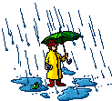
Engineering Design - Stormwater
Describe the Ecosystem
Define the Problem
Research the Problem
Understand the Stakeholders
Determine Possible Solutions
Develop a Plan
Implement and Test the Plan
Summarize, Evaluate, and Reflect

Slide 3
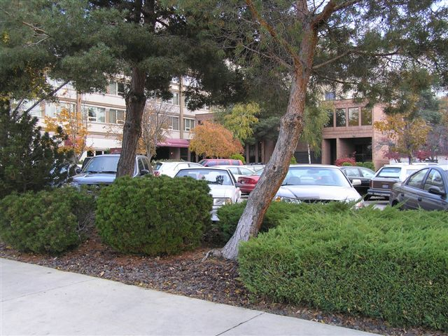
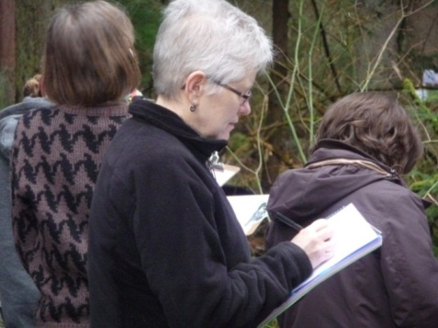
Research the Problem
Go outside and identify features in their schoolyard system that impact water flow and collection of pollution in that system.

Slide 4
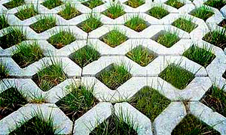
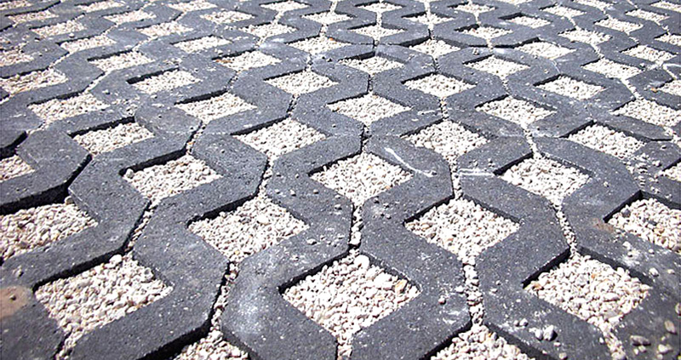
Pervious Surfaces

Slide 5
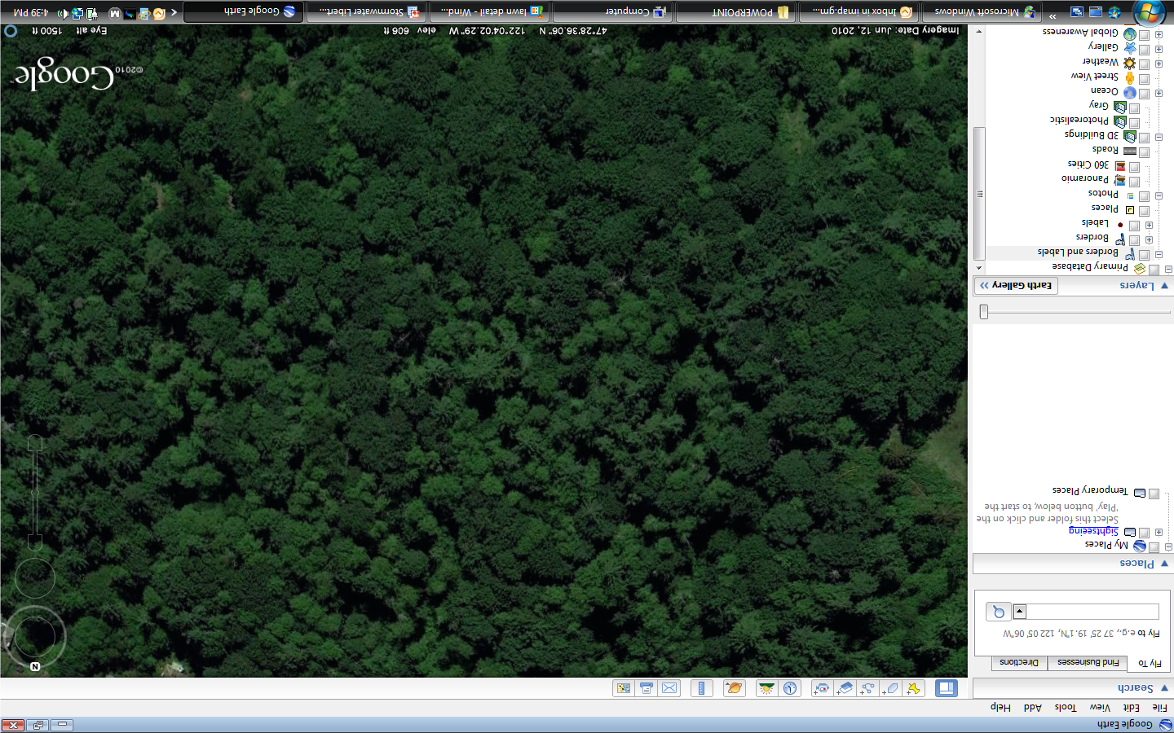
Define the Problem
Pervious Surfaces
Stormwater soaks in slowly and gets filtered before entering streams, rivers, and lakes.

Slide 6
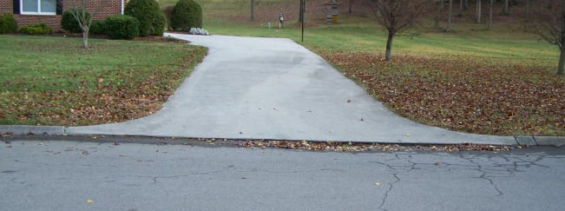
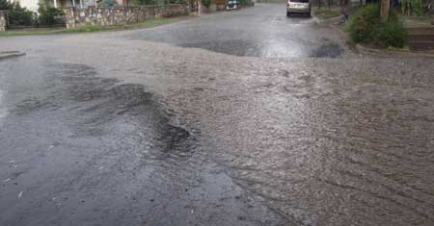
Impervious Surfaces

Slide 7
Define the Problem
Impervious Surfaces
Stormwater runs off quickly carrying pollution with it and causing flooding.

Slide 8
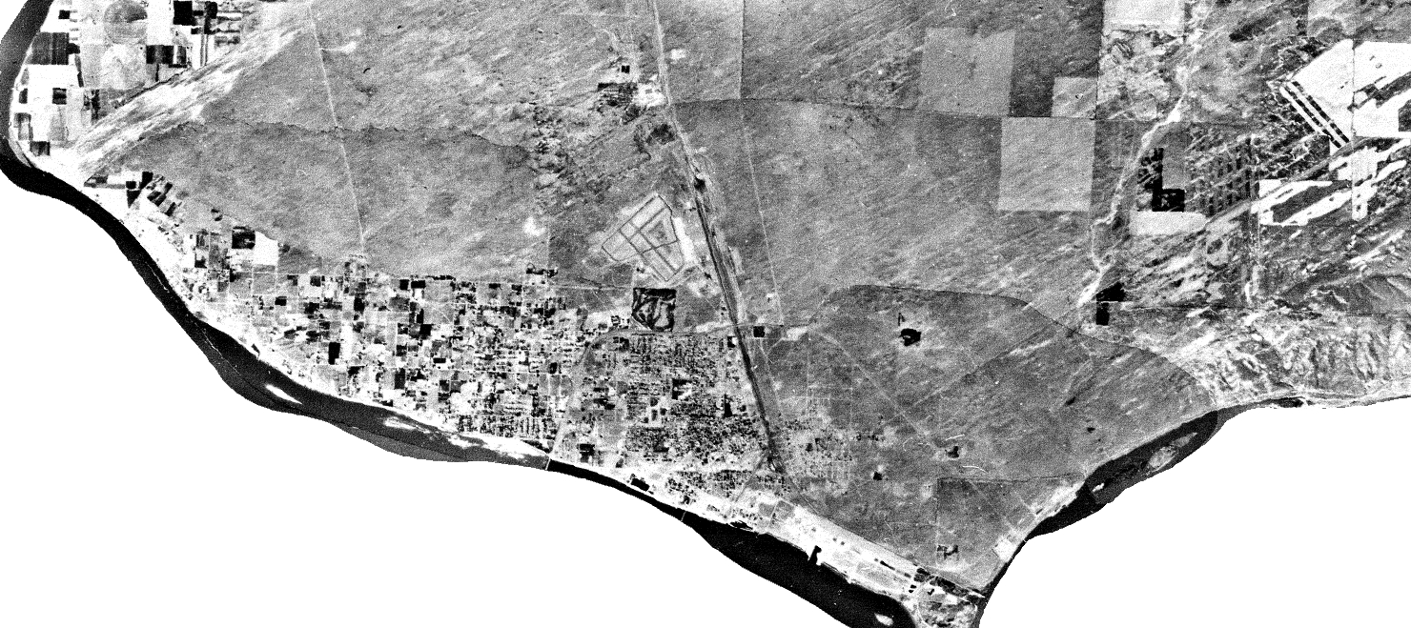
Then…1970
From Project Learning Tree-Mapping your Community Through Time and Project WILD- Then and Now
Franklin County, Washington

Slide 9
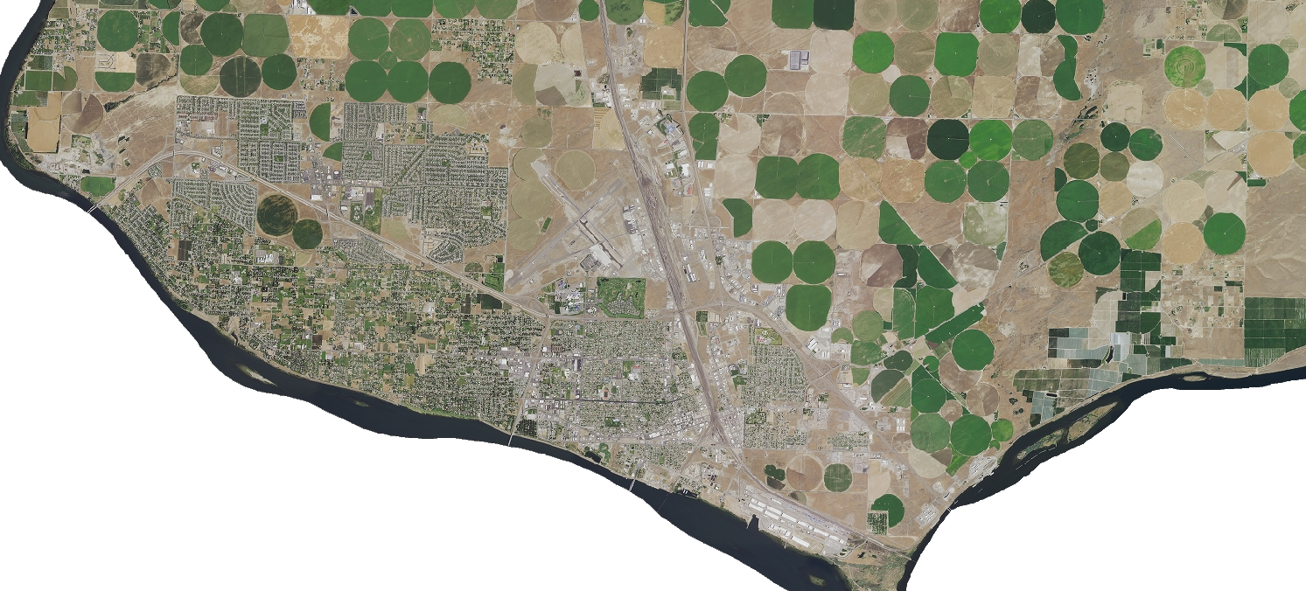
…and Now 2015
From Project Learning Tree-Mapping your Community Through Time and Project WILD- Then and Now
Franklin County, Washington

Slide 10
1970
2015
2015

Slide 11
Research the Problem
for pervious surfaces
for impervious surfaces

Slide 12
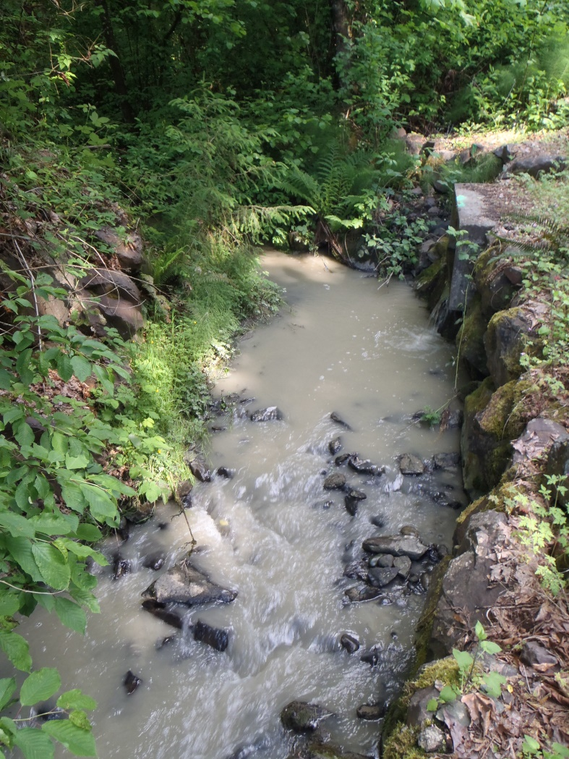
Research the Problem
Erosion
Photo of erosion making a stream cloudy
Symbol -

Slide 13
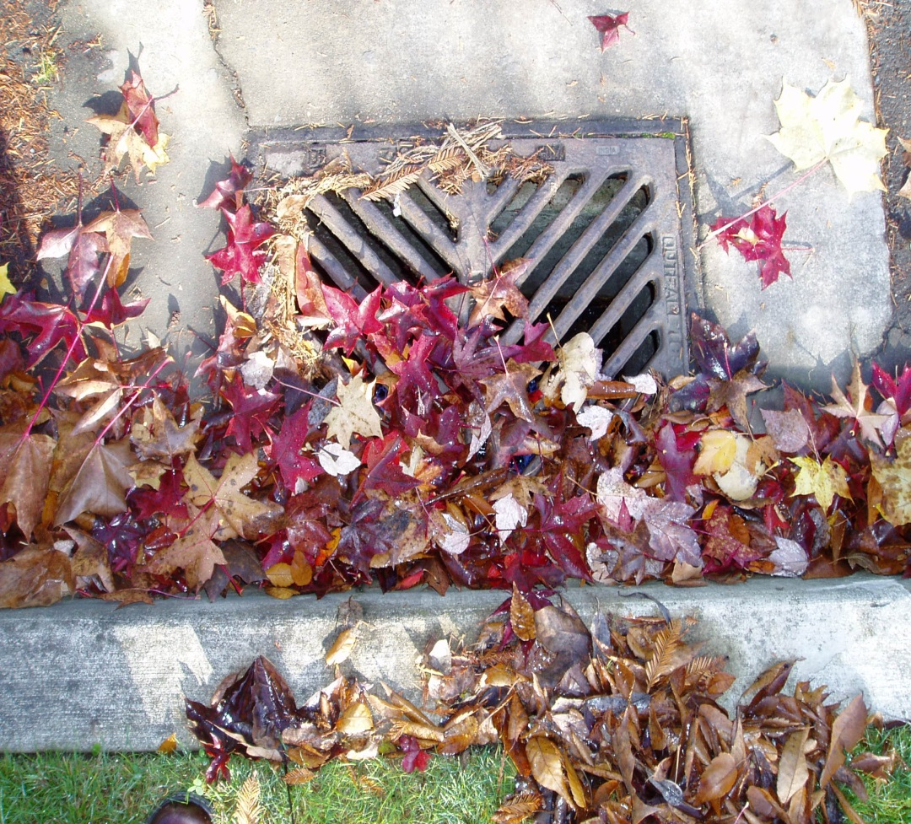
Research the Problem
Deposition
Deposition of materials-leaves, soils, twigs
Symbol -

Slide 14
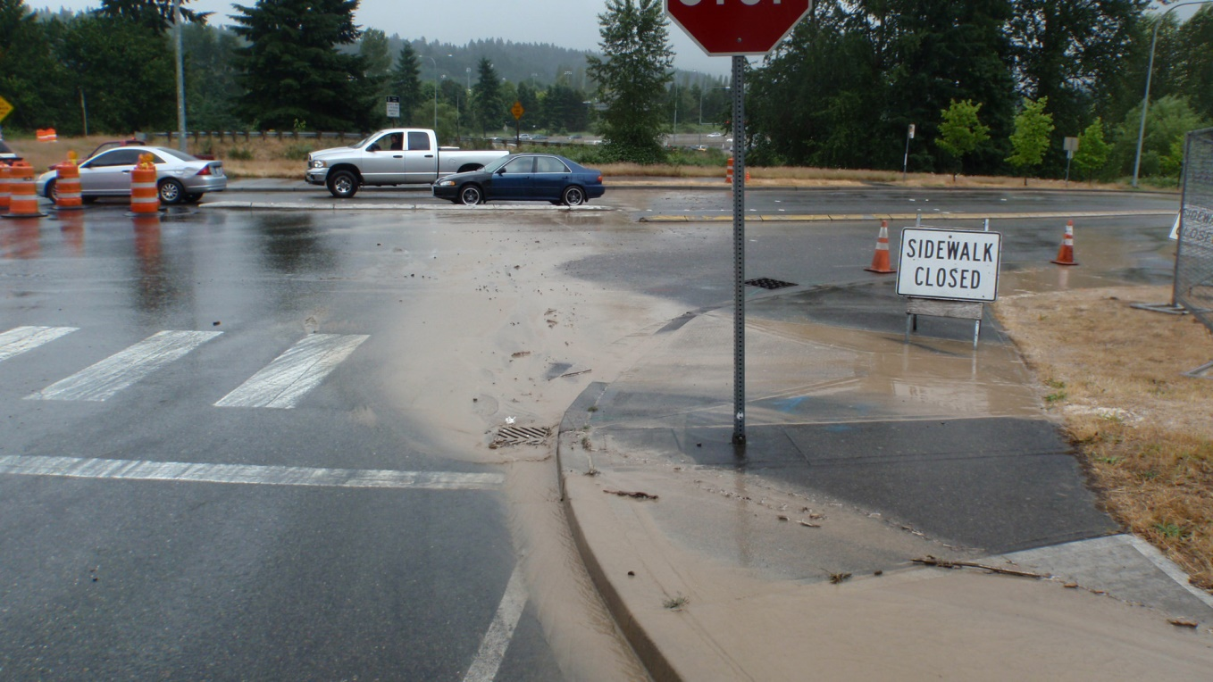
Research the Problem
Deposition and Erosion
Puddles or Totally Soaked Areas –this also shows erosion and deposition

Slide 15
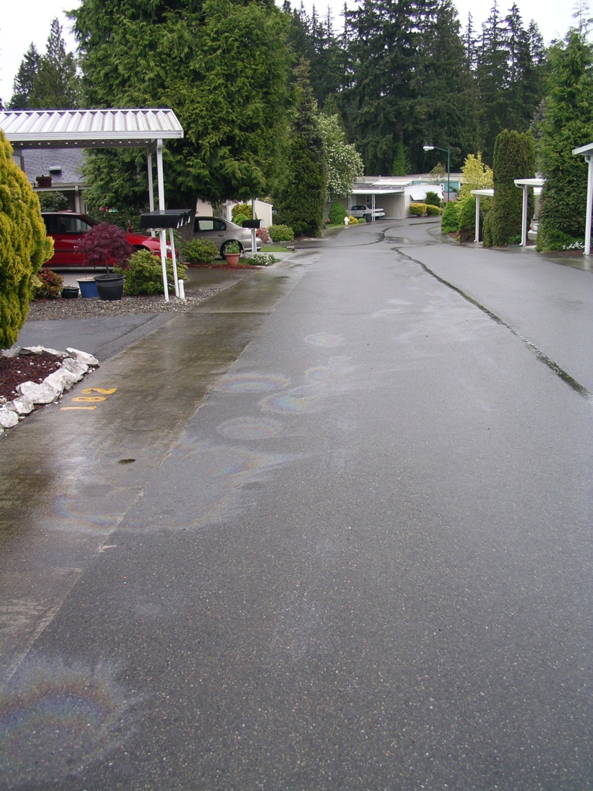
Research the Problem
Pollution
Rainbow sheen on concrete and asphalt
Symbol -

Slide 16
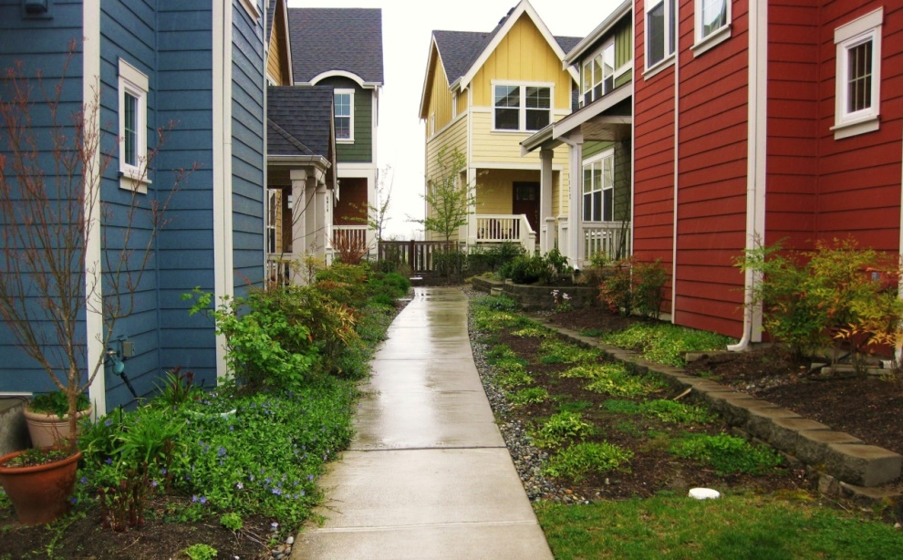
Research the Problem
Plants and soils to slow water down
Symbol -

Slide 17
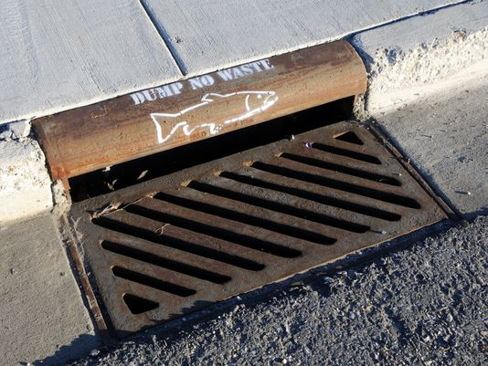
Research the Problem
Storm Drains
Storm drains lead to our rivers, lakes, and streams.
Symbol -

Slide 18
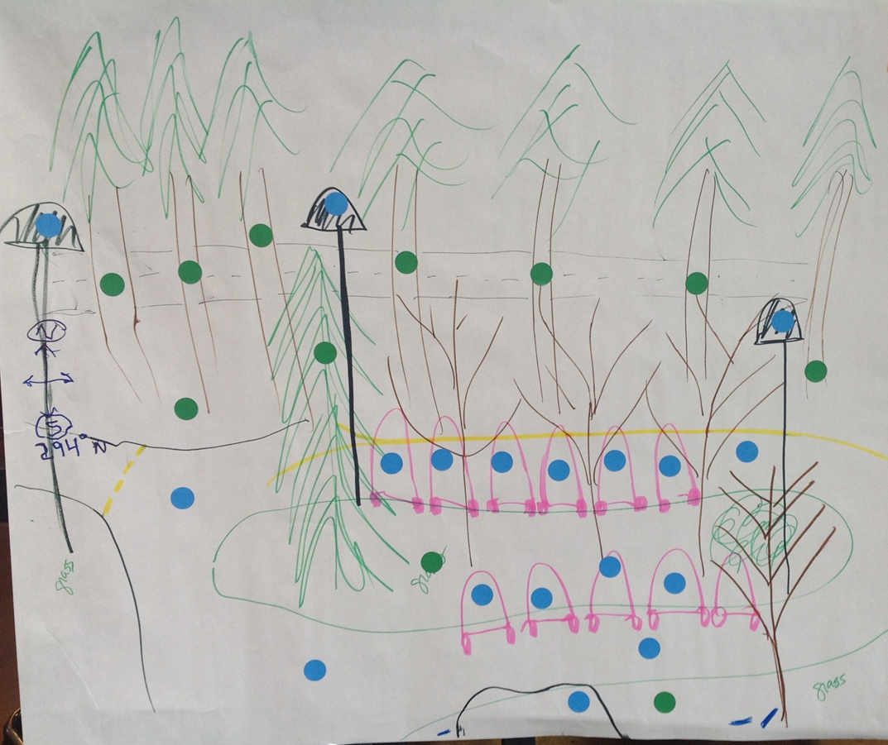
Research the Problem
for pervious surfaces
for impervious surfaces
Identify pervious and impervious surfaces on your group drawing.
From Project WET- Rainy Day Hike

Slide 19
Research the Problem
for pervious surfaces
for impervious surfaces
Next, identify features of stormwater runoff:
Puddles
Pollution
Deposition of debris
Erosion
Plantings/good soil
From Project WET- Rainy Day Hike

Slide 20
Research the Problem
Was there any observations that you found today that surprised you?
Describe where water went when it left your site.
Where did you see the greatest absorption of the water?
Where was there standing water?
Did you find any sources or potential sources of pollution?
What water ran over impervious surfaces? Did this water have a way to be cleaned by soil and plants or did it go directly into a drain?

