Slide 1
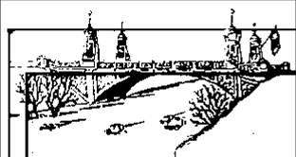
Stormwater – Watershed model
Lesson 3
City of Asotin
City of Clarkston

Slide 2
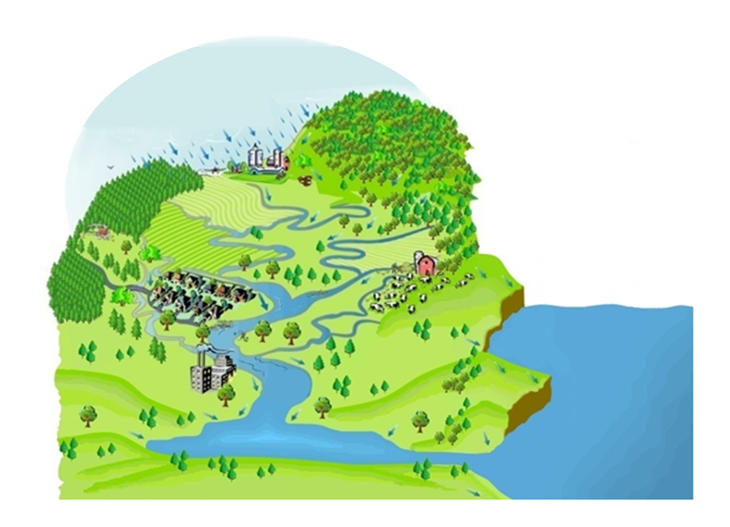
Every body of water has land that drains into it.
That land
is called a
watershed!

Slide 3
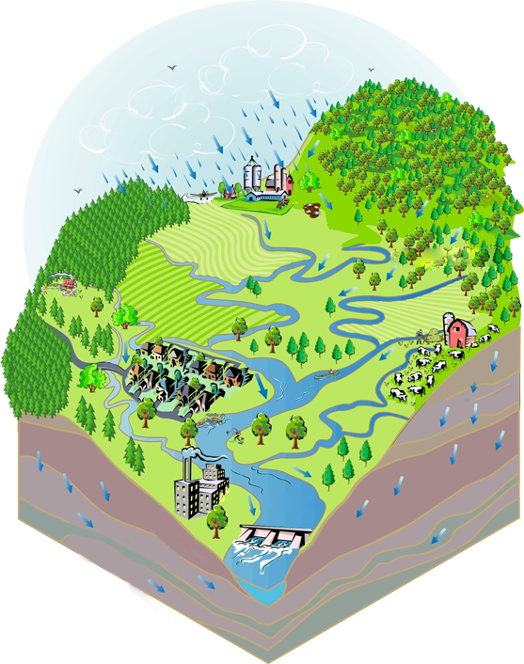
Which way is the water going?
Rainfall
Down!!
Into bigger bodies of water
Why?
Gravity
Groundwater
River

Slide 4
Natural Bodies of Water:

Slide 5
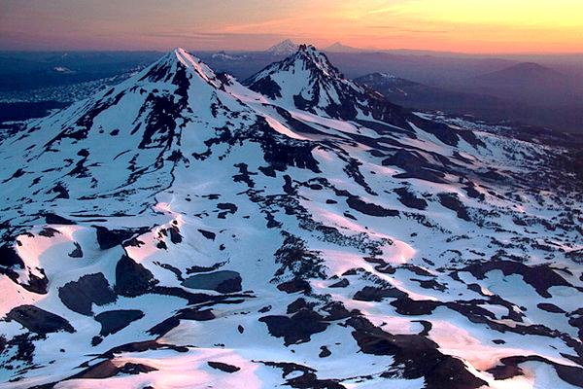
Mountains separate watersheds!

Slide 6
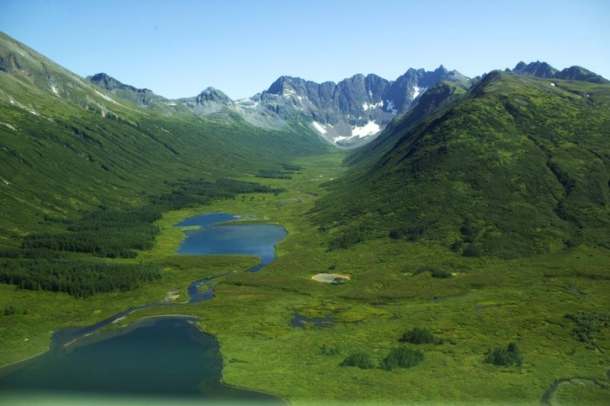
Valleys bring watersheds together!
Water shedding down the land and draining into bodies of water!

Slide 7
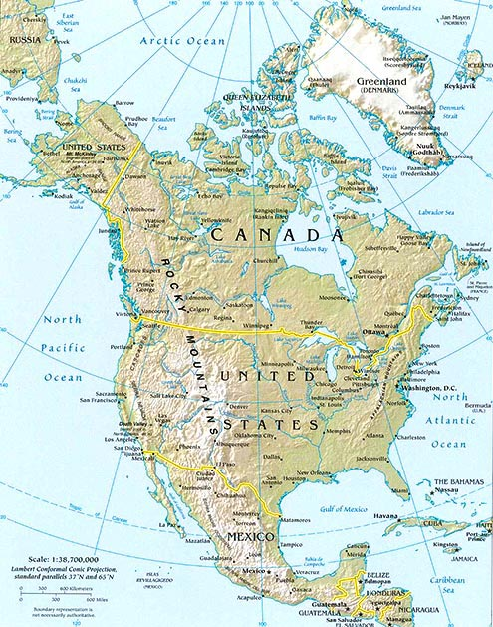
Watersheds can be different sizes
The Rocky Mountains separate North America into 2 watersheds

Slide 8
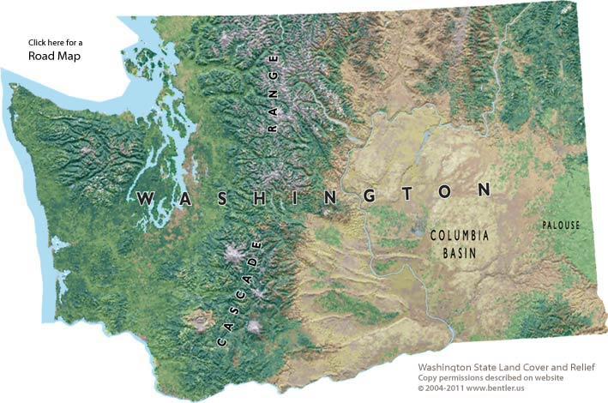
Watersheds can be different sizes
This side drains to the Columbia River
This side drains to the Pacific Ocean
The Cascades Mountains separate Washington into 2 watersheds

Slide 9
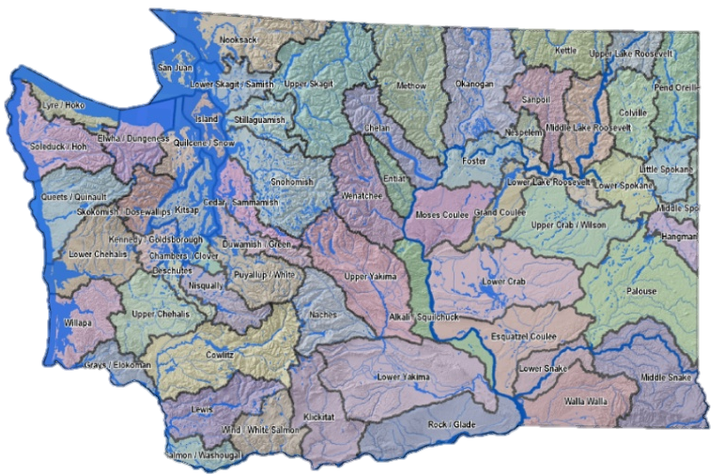
What watershed do you live in?

Slide 10
Let’s get some land & water!

Slide 11
Let’s put water on your watershed!
(Blue Marker)

Slide 12
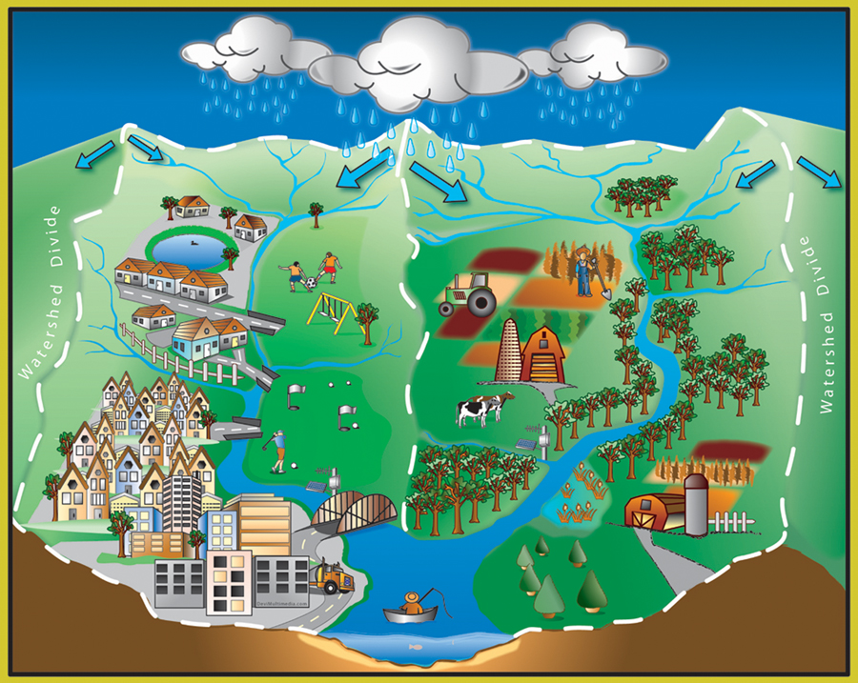
Pollution: Anything that does not belong on the land, in the air, or in the water.

Slide 13
Stormwater and Storm Drains
Only Rain Down the Drain!

Slide 14
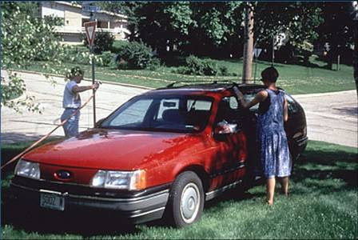
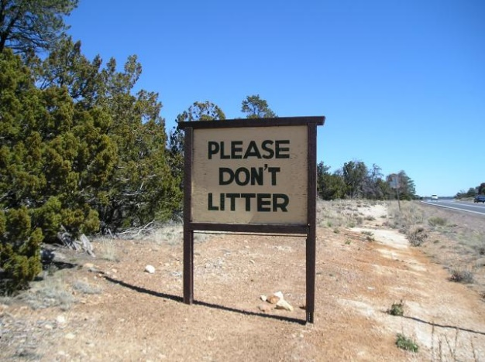
Do your part to keep your watershed clean and prevent pollution…
Pick up after your pets!
Wash the car in the grass!
Sweep your driveway and sidewalks!
Don’t litter!

Slide 15
Let’s add a farm! Don’t forget to protect the soil.
(green marker)
Let’s add a city!
(red marker)
Let’s add some roads!
(black marker)

Slide 16
Let’s test your models…let’s make it rain on your watershed!

Slide 17
What happened?
Were any buildings in the way of the path of the water? What might happen to buildings that are in the way of a raging river or a crumbling hillside?
How does the flow of water through a watershed affect our choice of building sites?
When the rainwater "washes" over the buildings, farms, and roads it changes color. This represents the water picking up pollution from the watershed. How might pollutants near the top of the watershed affect land near the bottom of the watershed?
In many parts of Eastern Washington it is generally dry, with occasional heavy rains. Think about your model. What does this mean for pollution runoff reaching streams and rivers during heavy rainfall in the watershed?

