Slide 1
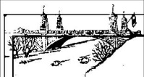
Stormwater – engineering Design and defining the problem
Lesson 6
City of Asotin
City of Clarkston

Slide 2
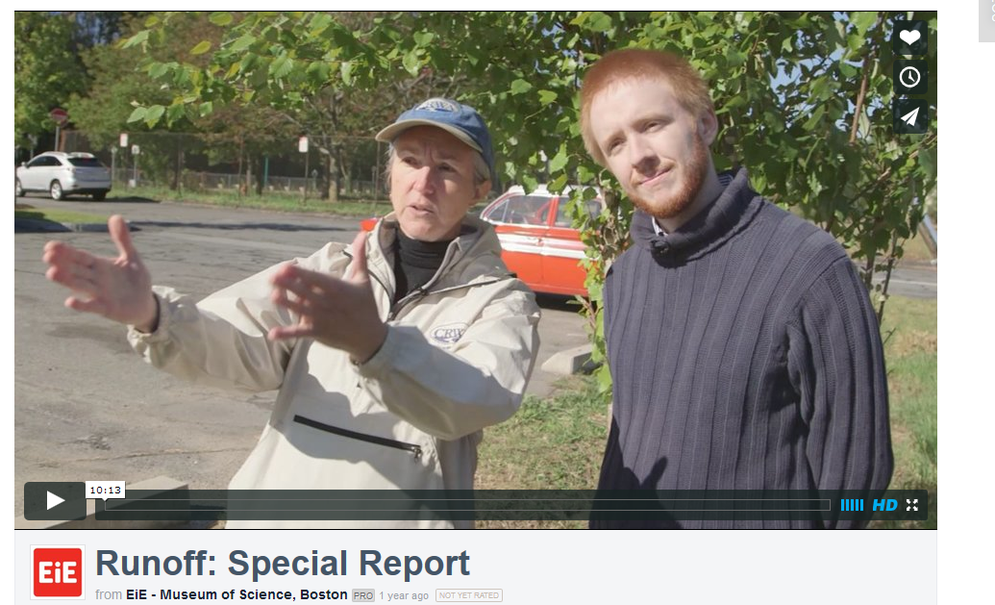
Engineering Design Video – “Runoff: Special Report”

Slide 3
Engineering Design-NGSS Terms
DEFINE
IMPLEMENT
OPTIMIZE
Explore SOLUTIONS
RESEARCH
Adapted from Runoff: Special Report Video- http://www.eie.org by Patricia Otto, Pacific Education Institute

Slide 4
Engineering Design-Terms in Video
http://www.eie.org/engineering-everywhere/resources/runoff-special-report

Slide 5
Engineering Design-terms In Video
Terms used in NGSS
Terms used in Video
Define the Problem | Identify
Research the Problem | Investigate
Develop Solutions: Explore and Evaluate Possible Solutions | Imagine
Plan | Plan
Implement | Create
Test | Test
Optimize | Improve
Communicate | Communicate

Slide 6
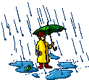
Engineering Design-Stormwater
Describe the Ecosystem
Define the Problem
Research the Problem
Understand the Stakeholders
Explore and Compare Possible Solutions
Develop a Plan
Implement the Plan and Test
Optimize (Improve)
Communicate

Slide 7
Define the Problem
Stormwater-Surface Water Runoff
Quantity- too much surface water runoff causing erosion and flooding
Quality- pollutants from land surfaces being carried by surface water runoff into waterways- aquifers, streams, rivers, and lakes

Slide 8
Engineering Design - Stormwater
So we’ve defined our problem as the quality and quantity of stormwater runoff in our community.

